Slide 1
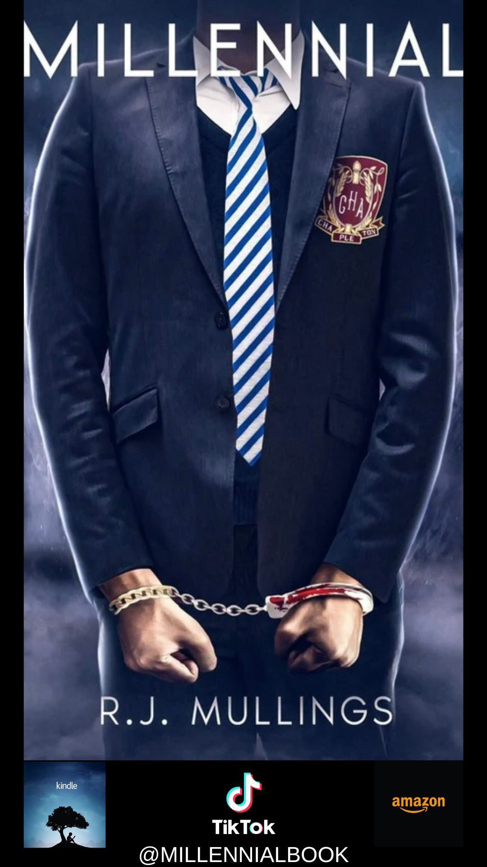
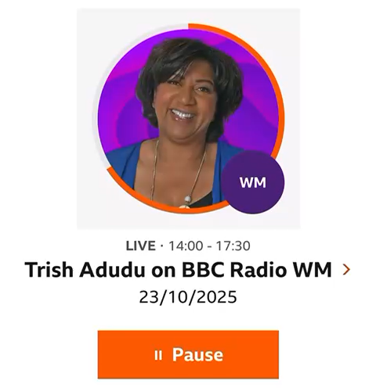
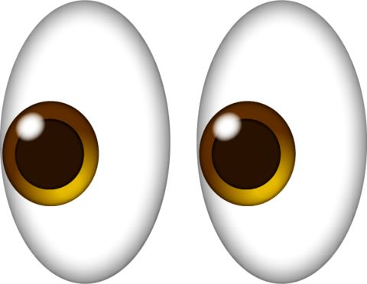



What is Millennial???
Why did R.J. Mullings write it???
Who is R.J. Mullings???
Press play on the BBC WM Radio interview to find out more.
Read the preface in the book the Amazon link is here: Millennial: A Gripping Crime Drama Exploring the Modern Day Struggles of Education, Society and Justice : Mullings, R.J.: Amazon.co.uk: Books
R.J. Mullings is a man from the West Midlands, a Vice Principal and has a passion for helping young people realise their potential and achieve success. He began his career in education as an English Teacher so has always enjoyed reading and writing. He used a gift he was blessed with to write Millennial and he hopes it inspires young people to unlock their gifts, maybe discover new talents, strive for more in life and most importantly stay safe.
Millennialenquiriesuk@gmail.com

Slide 2
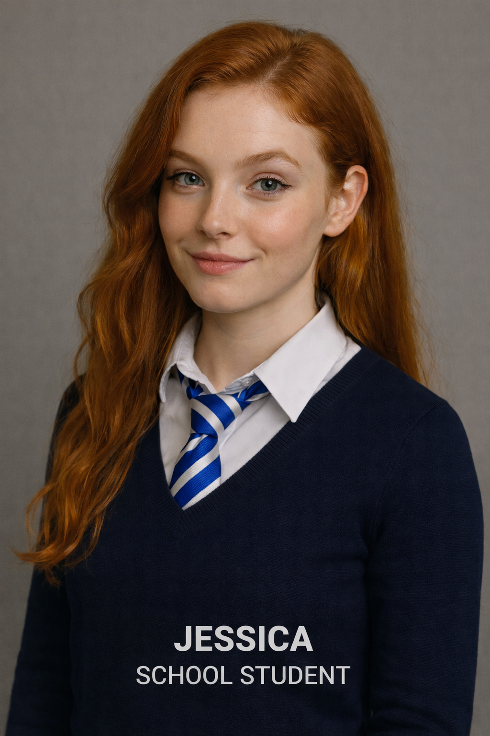


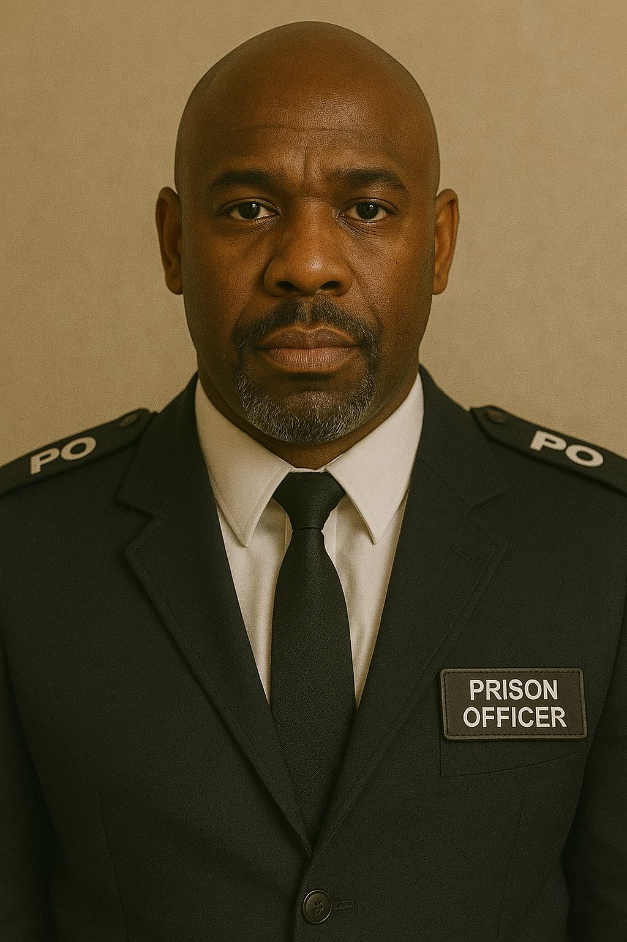
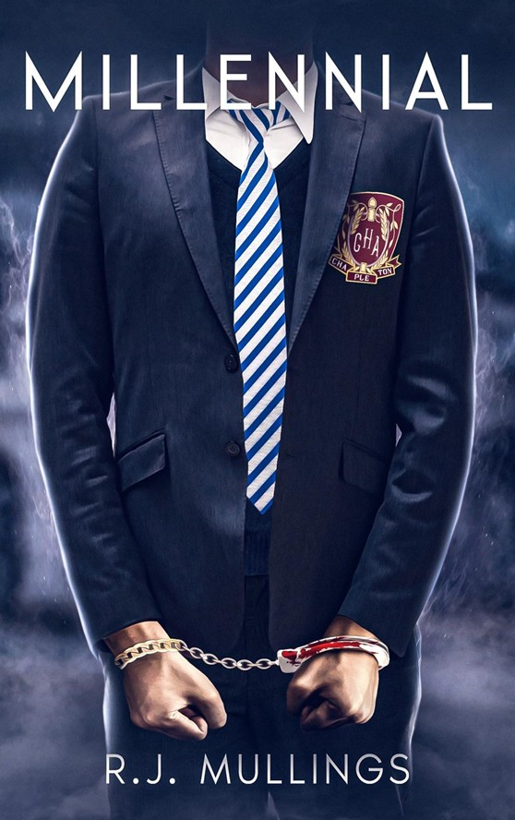
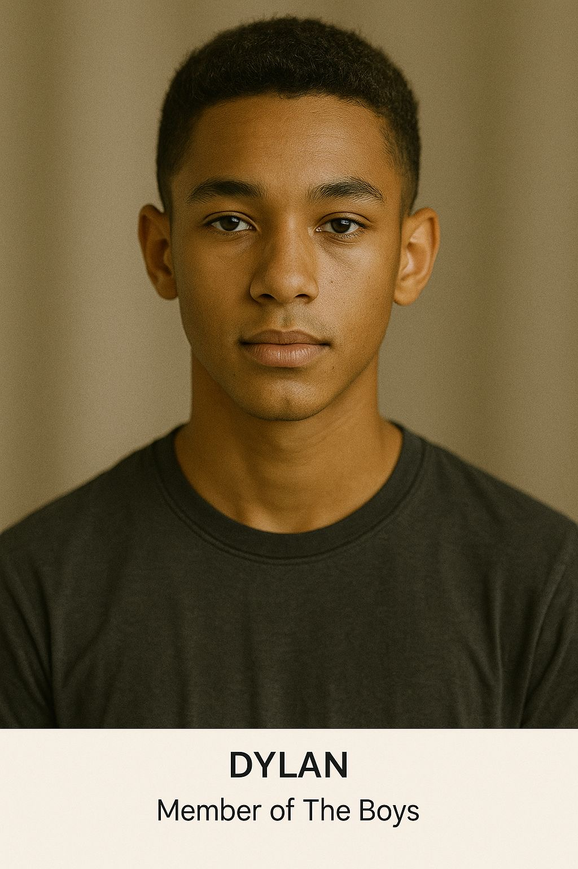
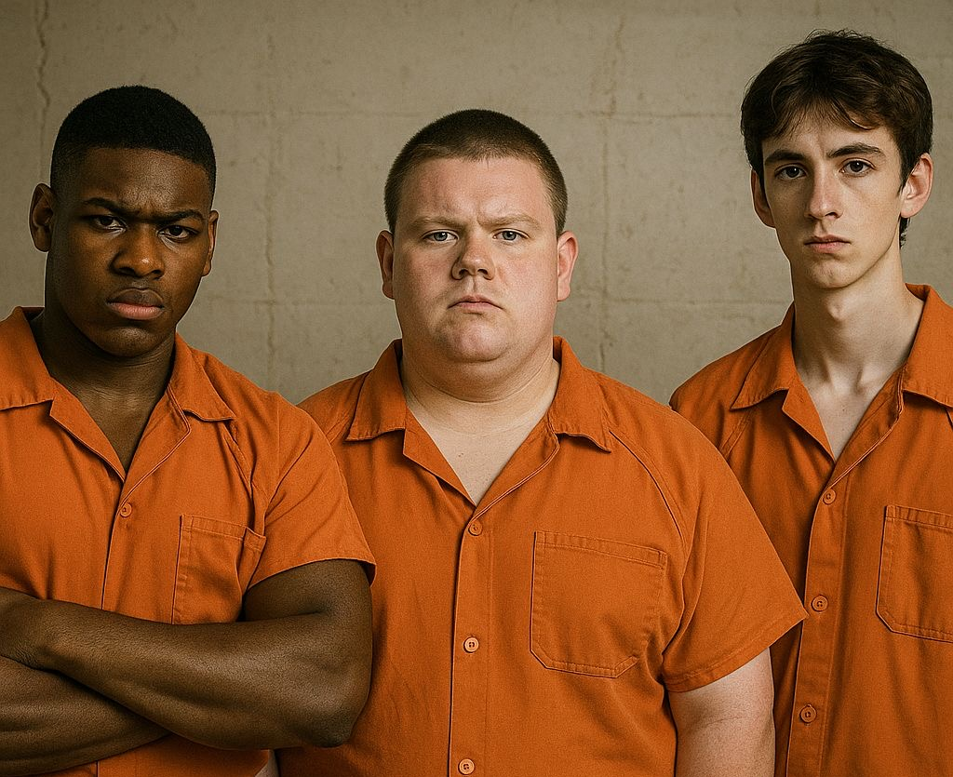
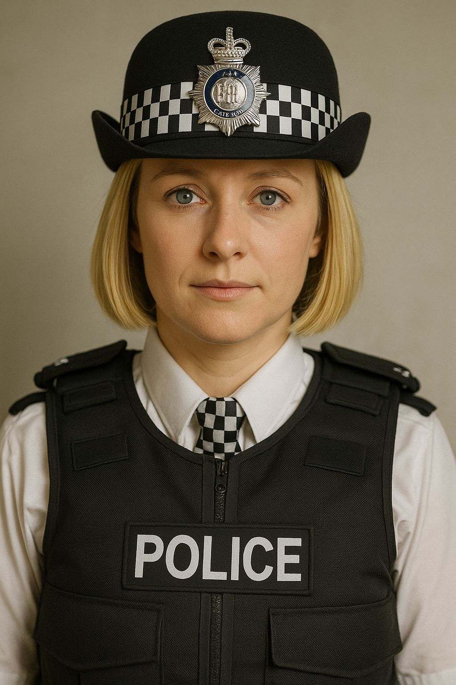
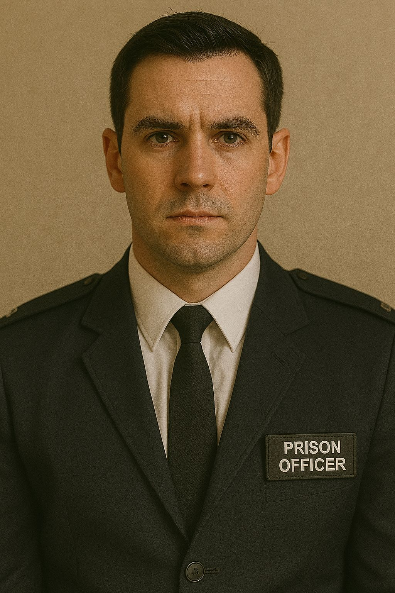
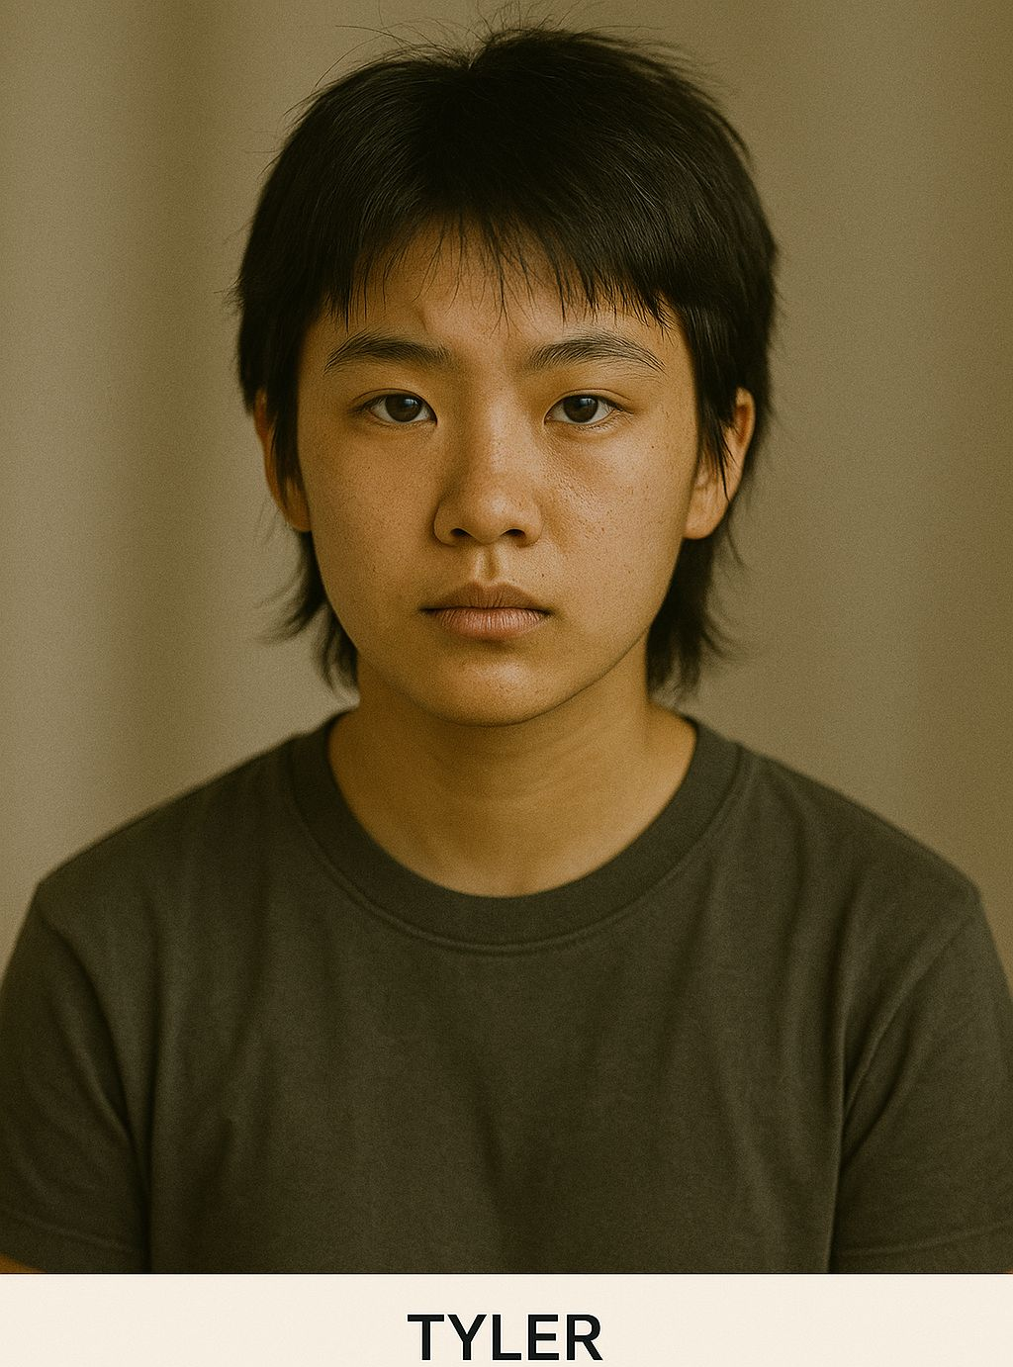
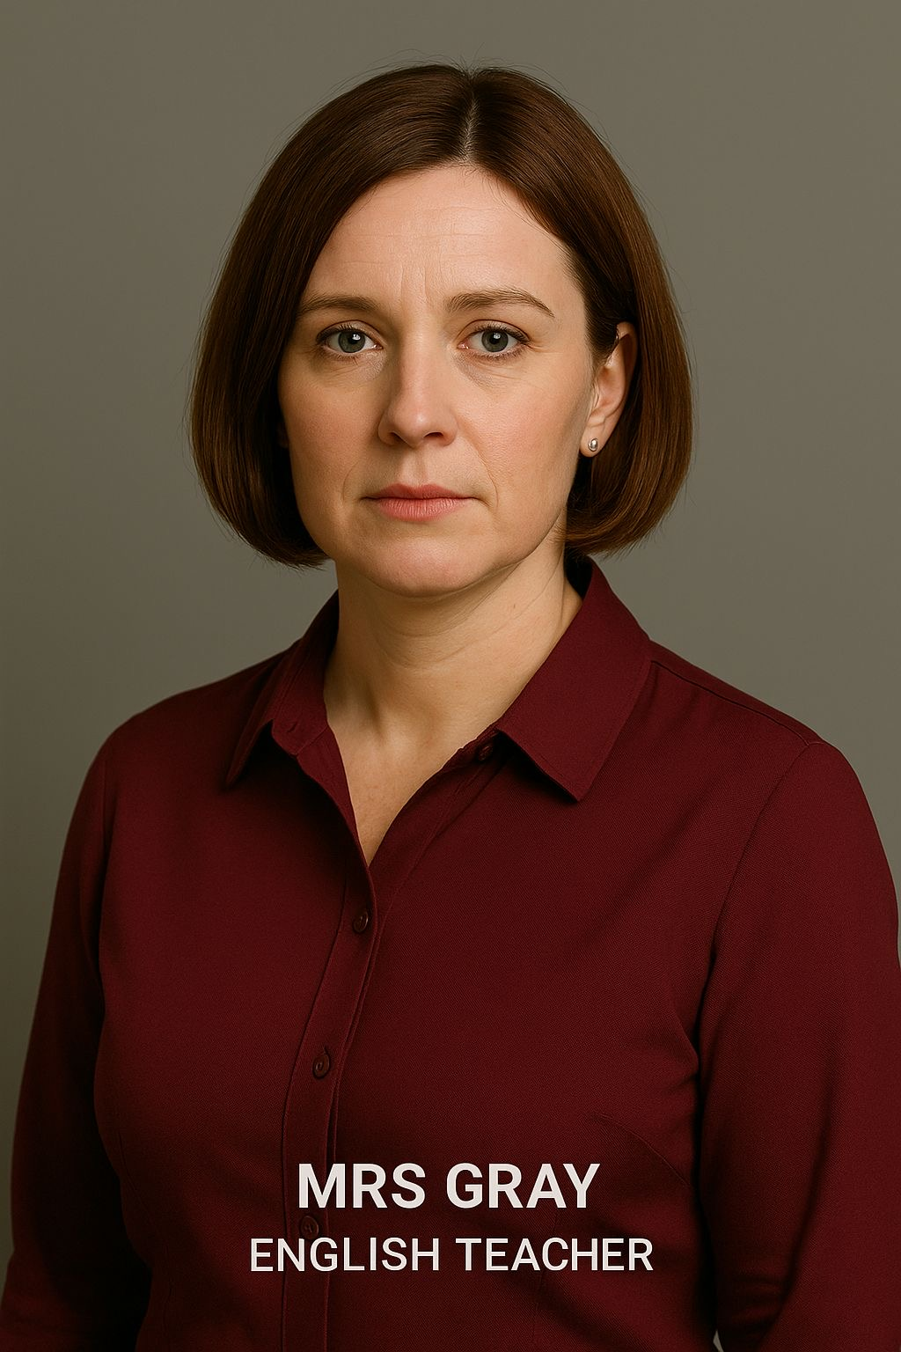

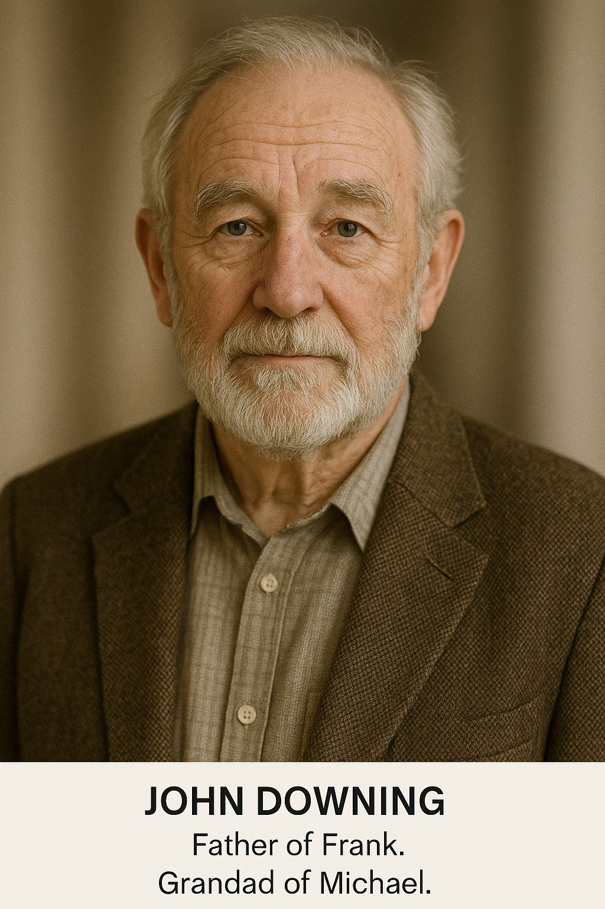
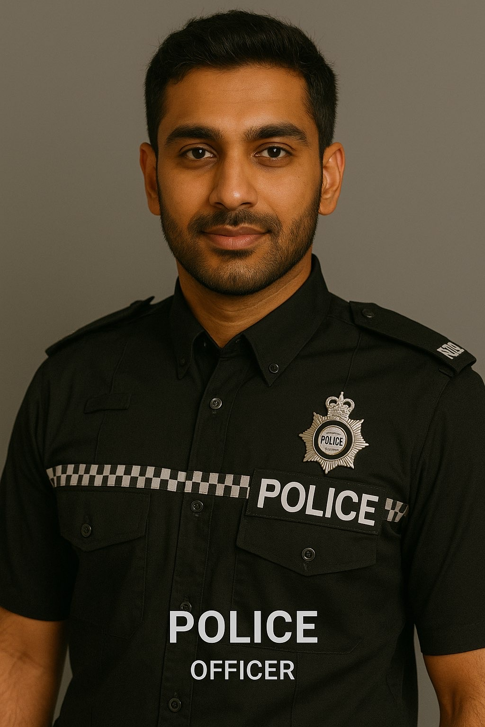
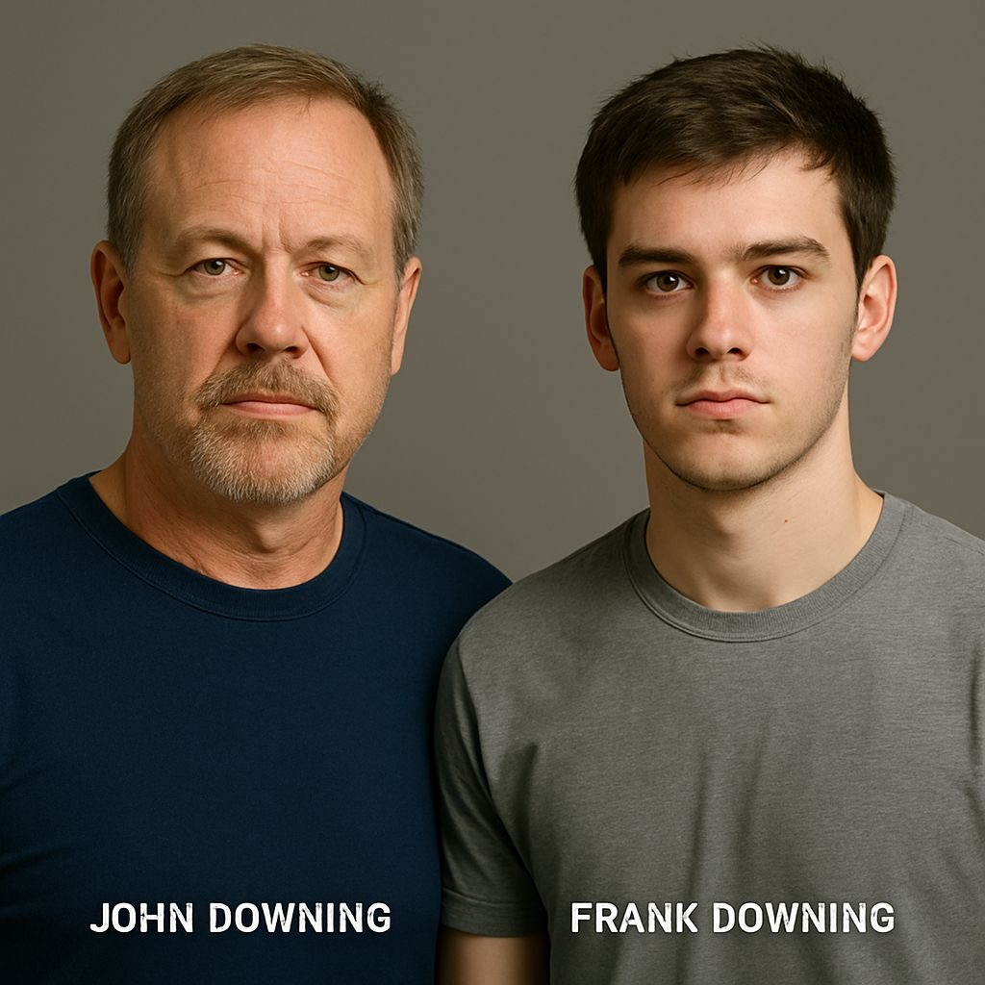
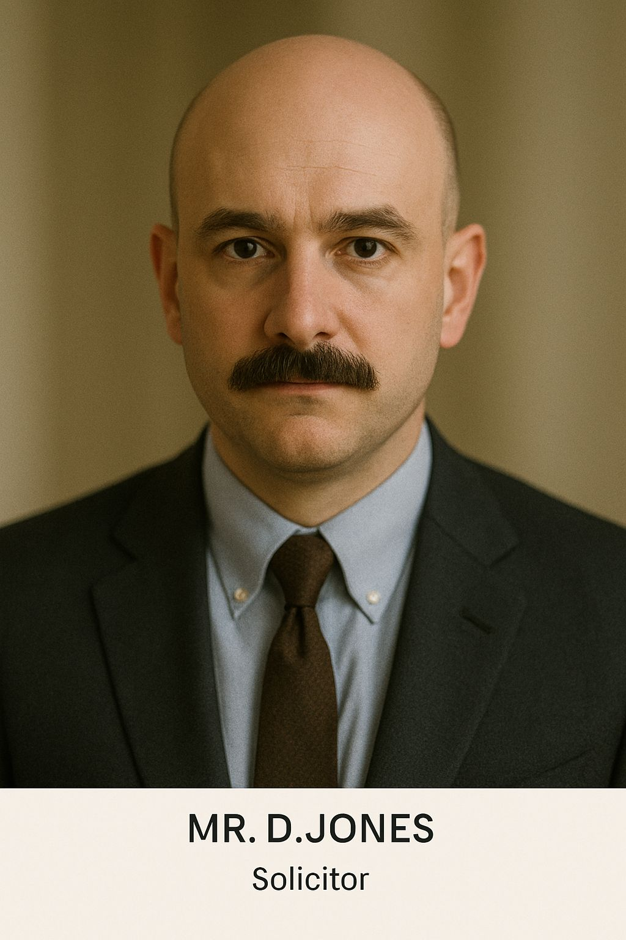

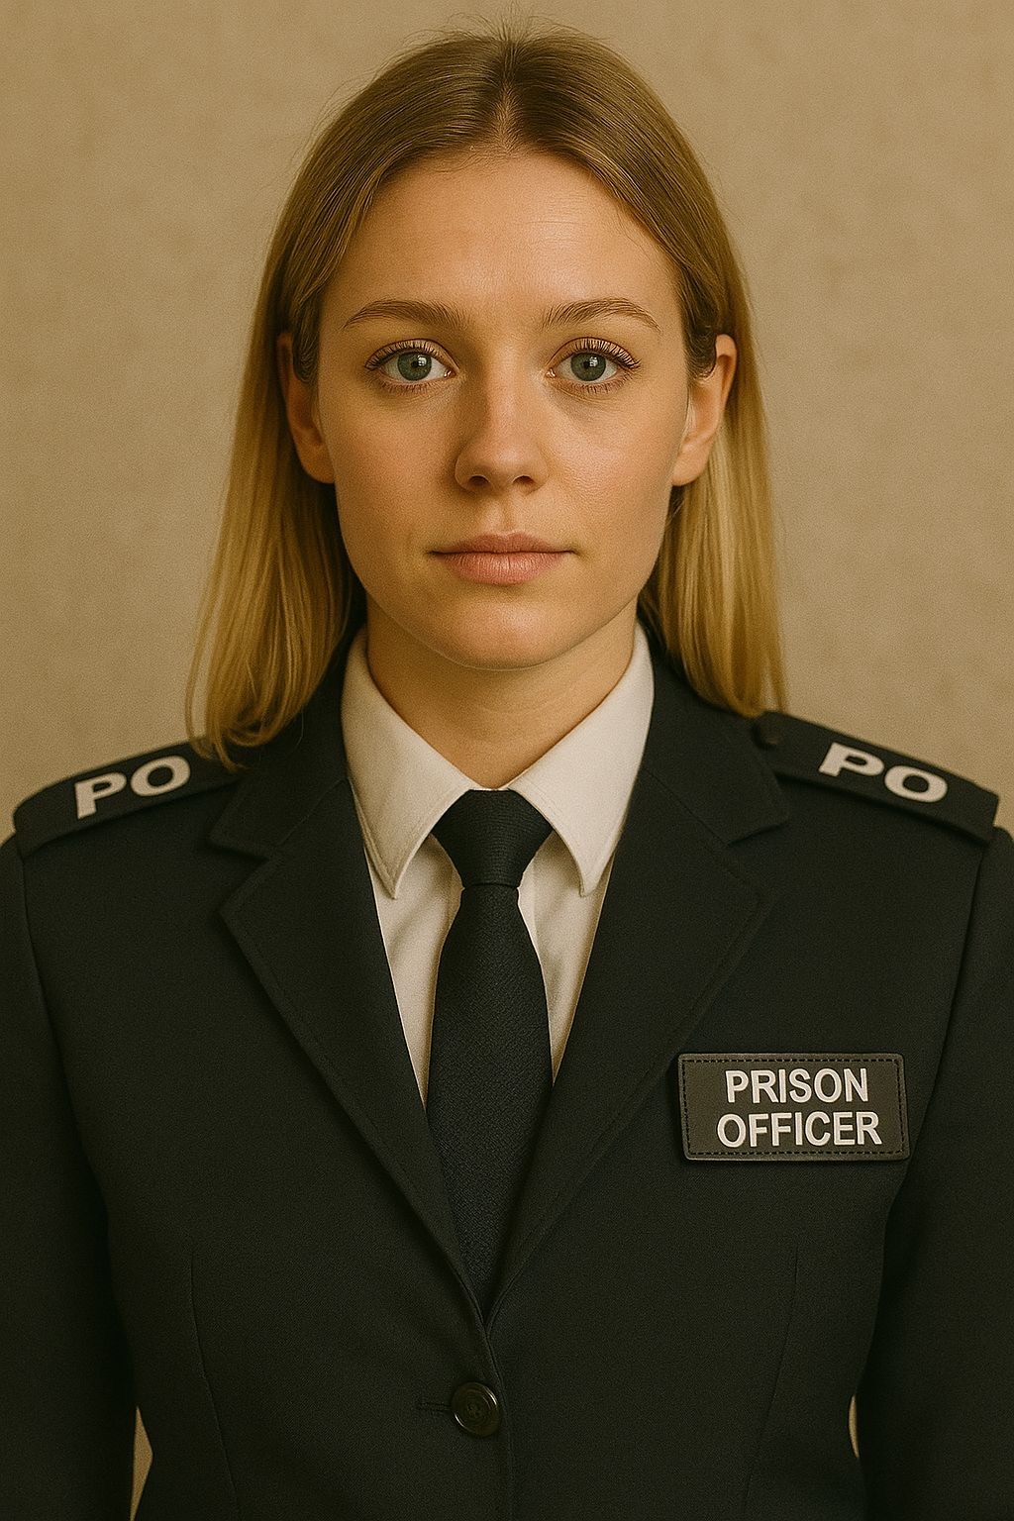
Character List
Michael Downing (M) – Year 10 student.
Jane Downing (F) – Mother of Michael & Amy.
Frank Downing (F) – Father of Michael & Amy.
Amy Downing (F) – Michael’s older sister.
John Downing (M) – Father of Frank.
P.C Davies (M) – Police investigator.
Mr D. Jones (M) – Solicitor.
Doctor (M or F) – Doctor at St. Chads Hospital.
Blake (M) – Leader of The Boys.
Dylan (M) – Member of The Boys.
Tyler (F) – Member of The Boys.
Driver (F) – Driver of the Vehicle involved in the accident.
George Hayhurst (M) – Head teacher at Chapleton High School.
Catherine Hayhurst (F) – Wife of George Hayhurst.
William Hayhurst (M) – Son of George Hayhurst.
Mrs Cartwright (F) – Chapleton School receptionist.
Mrs Gray (F) – Michael’s English Teacher.
Police officers (M&F) – Police officers with P.C Davies.
Jessica (F) – Girl in class.
Prison inmate 1 (M), Prison inmate 2 (M), Prison inmate 3 (M)
Prison officer 1 (M), Prison officer 2 (M), Prison officer 3 (F)

Slide 3
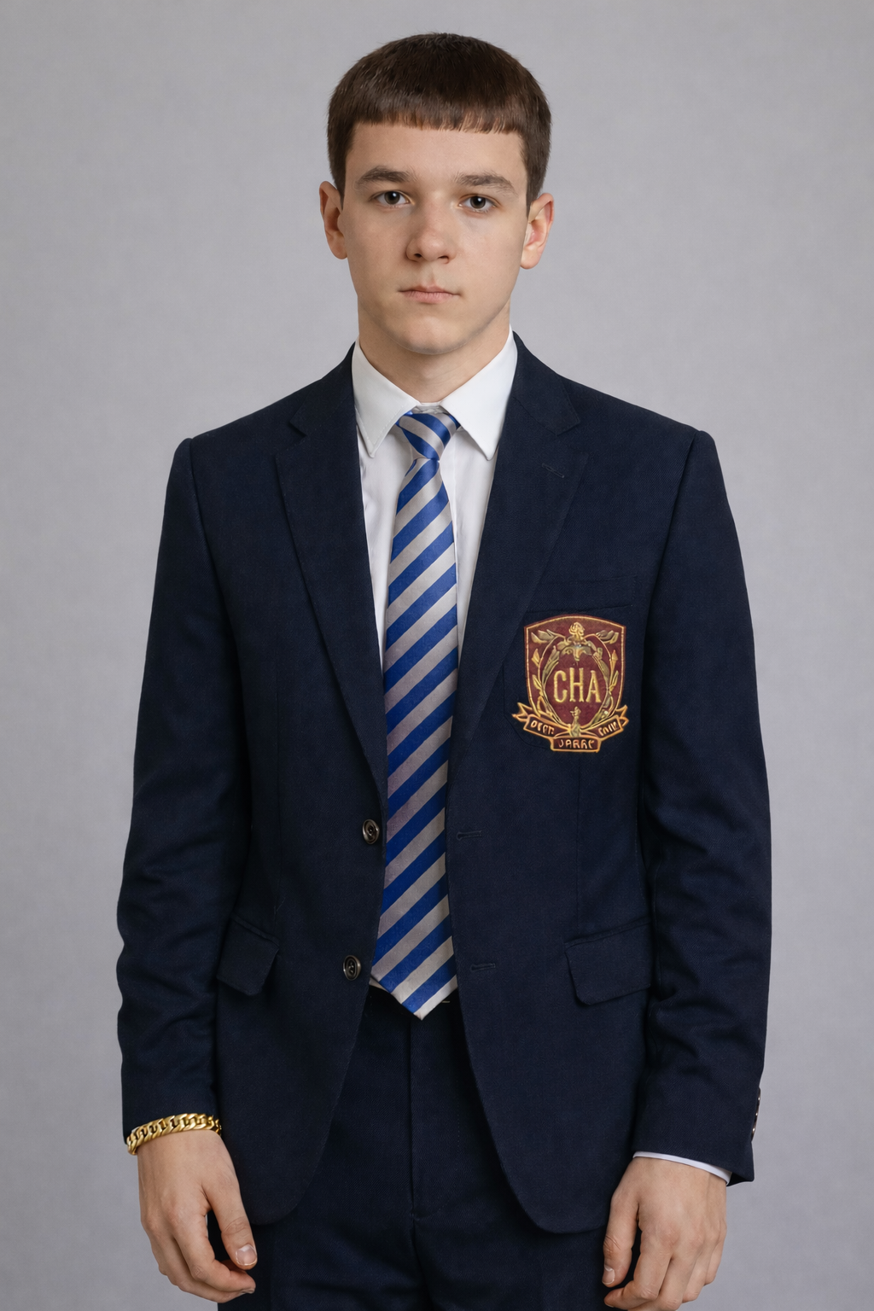
How does he link to the key themes: Youth Violence and Knife Crime, Peer Pressure and Masculinity, Education and Aspiration, Justice and Moral Choice, Family and Community Responsibility
Mullings presents Michael as a young person trapped in a cycle of violence he did not initiate. His decision to carry a knife shows how knife crime spreads not only through aggression, but through fear and perceived necessity. Michael’s arrest demonstrates how victims can quickly become criminalised, reinforcing the play’s safeguarding message.
Michael internalises toxic ideas of masculinity, believing that respect must be earned through confrontation. His final decision to confront Blake is driven by shame and humiliation rather than confidence. Mullings critiques how male identity is policed by peers, leaving young men emotionally isolated and prone to risky behaviour.
Michael’s aspirations make him a target rather than a success story. Mullings highlights how schools can misinterpret vulnerability as defiance, pushing students closer to exclusion rather than protection. Michael’s near-managed move symbolises how systems often remove the child instead of addressing the risk.
Michael’s moral conflict is central to the play. Mullings shows that justice is not simply about right and wrong, but about fear, consequences, and survival. Michael’s silence reflects a breakdown in trust between young people and authority.
Michael’s actions are driven by a desire to restore family honour and prove his worth. Mullings suggests that communities — families, schools, police — must work together to protect young people. When they fail, individuals like Michael are left to navigate danger alone.
Quotations
Interpretations, analysis and context
Michael Downing is the central protagonist of MILLENNIAL. He is a Year 10 student presented as intelligent, reflective, and aspirational, but deeply vulnerable to peer pressure and societal expectations of masculinity. Throughout the play, Michael is caught between his desire to succeed educationally, his need for respect, and his fear of being labelled weak or a “snitch”. His journey exposes how youth violence, institutional failure, and harmful codes of masculinity can push ordinary young people towards tragic choices.
Michael is not inherently violent; instead, he is reactive, acting out of fear, shame, and a desire to protect his identity, family honour, and future.
Michael’s involvement with knife crime is reluctant and fear-driven, not predatory. He becomes a victim of youth violence when he is chased by peers and run into the road, leading to significant injuries. Later, he carries a knife himself, believing it is the only way to protect himself and regain what was stolen.
Michael is repeatedly mocked for valuing education and emotional honesty. Blake and “The Boys” weaponise masculinity, equating strength with dominance, silence, and aggression.
Unlike many of his peers, Michael values education and sees it as a route to a better future. However, the education system repeatedly fails him, misjudging his behaviour and prioritising reputation over safeguarding.
Michael faces multiple moments where he could tell the truth — to the police, his parents, or school leaders — but chooses silence to avoid being labelled a “snitch.”
Michael’s family represents conflicting pressures: his mother offers emotional support, while his father emphasises discipline, reputation, and traditional masculinity. The stolen bracelet symbolises intergenerational responsibility and identity.
Michael represents a generation of young people navigating fear, expectation, and systemic failure. He is neither hero nor villain, but a realistic portrayal of how safeguarding gaps, toxic masculinity, and youth violence intersect. Through Michael, Mullings argues that early intervention, listening, and empathy can prevent tragedy.
“I didn’t even want to stab anyone… this is just for protection.”
“It all happened so quickly.”
“If you’re not with us, you’re against us.”
“You want to be like your sister and go to university, so you want to be a girl now?”
“What kind of man would that make me?”
“I don’t want to get kicked out of this school, I want to get good grades.”
“You just want to get rid of me.”
“I should have told the police exactly what happened… but I couldn’t.”
“If I told the police it would ruin me.”
“That bracelet has been in our family for four generations.”
“Damned if I do, damned if I don’t.”
“Trying to forget about what I love most brings a tear to my eye, but I’m a man in here we are not allowed to cry”

Slide 4

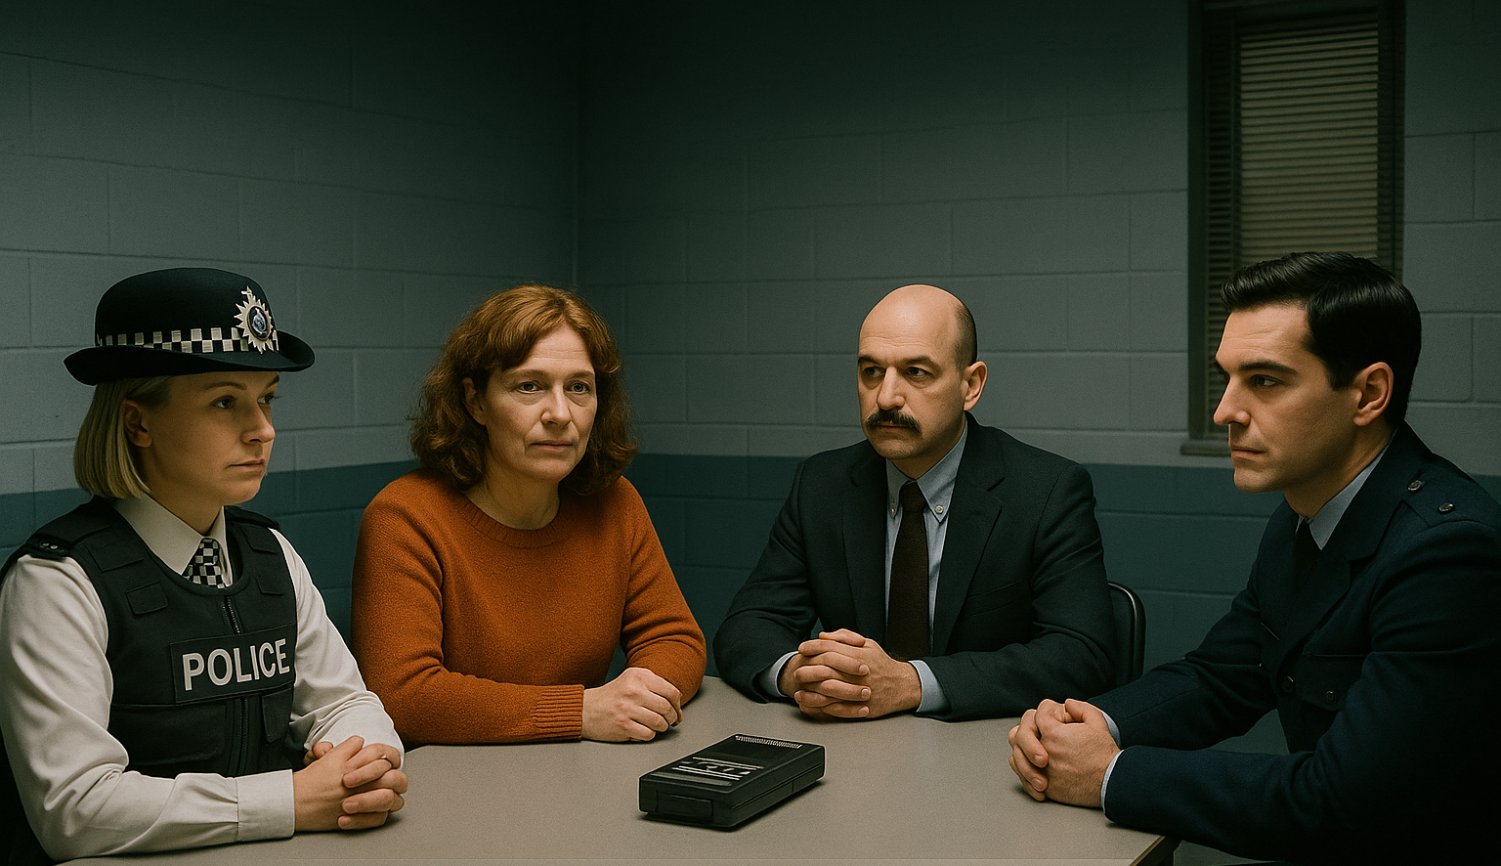
SWAP BOOKS (Guided by Teacher) Using the success criteria you are given by your teacher, analyse the PETAZL Paragraph you have produced.
Peer Assessment
🟥 P – Point
✔ Make a clear argument that answers the question ✔ Focus on what Mullings presents (theme, character, idea) ✔ Use confident academic language
🟦 E – Evidence
✔ Use a short, relevant quotation from the text ✔ Embed the quote smoothly into your sentence ✔ Choose evidence that directly supports your point
🟨 T – Technique
✔ Identify how Mullings creates meaning ✔ Use subject-specific terminology ✔ Techniques can include:
Stage directions, Dialogue, Symbolism (e.g. the bracelet), Structure (flashbacks, silence, pauses)
🟪 Z – Zoom
✔ Zoom in on one word or detail ✔ Analyse language, movement, or silence ✔ Show perceptive thinking (Grade 7–9 skill)
🌟 Grade Guidance
Grade 4–6: P, E, A, L secure
Grade 7: Clear T and Z
Grade 8–9: Perceptive Zoom + confident Link to authorial intent
🟧 L – Link
✔ Link back to the question or theme ✔ Mention Mullings’ message or intention ✔ Show why this matters overall
🟩 A – Analysis
✔ Explain why the evidence is important ✔ Explore meanings, emotions, and effects ✔ Link back to the question

Slide 5
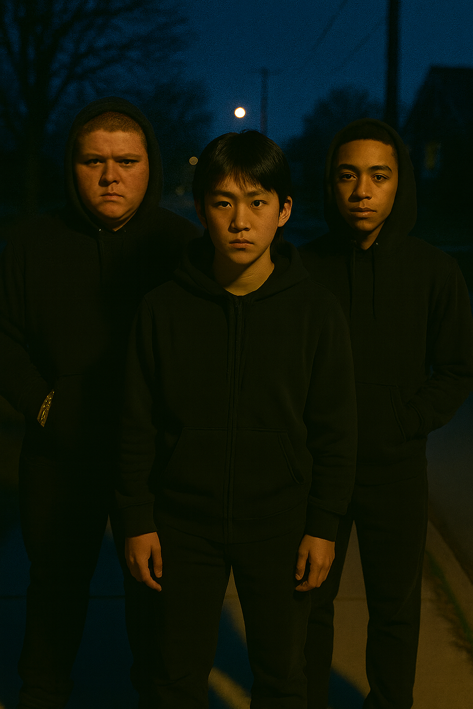
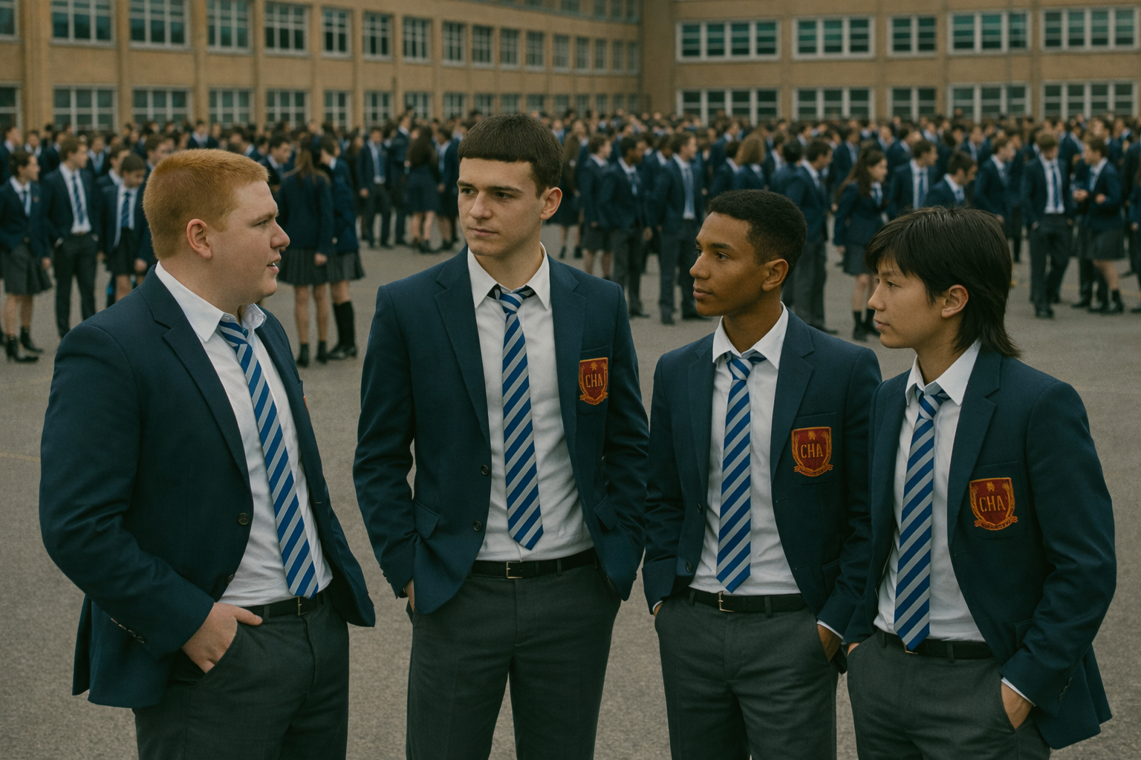
Lesson 4: Blake and ‘The Boys’ – Peer Pressure and Toxic Loyalty
Learning Objectives
**: I can identify who Blake and ‘The Boys’ are and describe one way they pressure Michael.
***: I can explain how Blake and ‘The Boys’ make Michael feel pressured, using evidence from the text.
****: I can analyse how Mullings presents Blake and ‘The Boys’ as dangerous using dialogue, themes and stage directions.
*****: I can evaluate why Mullings presents Blake and ‘The Boys’ as a source of danger and the message this sends to the audience.

Slide 6
Final mini Task: Exit Ticket (Reflection – 3 minutes)
Choose ONE: Ensure your response has quotations embedded.
One way Blake uses fear rather than force
One reason loyalty is dangerous in the play
One question you still have about Michael’s choices
Task 2: Pressure Mapping (Visual Task – 8 minutes)
Task
In the centre of the page, write MICHAEL. Around him, add arrows labelled with pressures created by Blake and ‘The Boys’.
Examples:
Fear of retaliation
Fear of being labelled a “snitch”
Pressure to prove masculinity
Pressure to choose sides
Extension
Label each pressure as emotional, physical, or social
Task 1
Read the definition below:
Toxic loyalty is when someone feels forced to stay loyal to a group even when it causes harm to themselves or others.
Questions (Think–Pair–Share)
How is loyalty usually seen as a good thing?
When does loyalty become toxic?
Which expectations do Blake and ‘The Boys’ place on Michael?
Task 3: Language of Control (AO2 Focus – 10 minutes)
Task
Read a short extract where Blake speaks to Michael.
Highlight:
🔴 Words that threaten
🔵 Words that shame
🟡 Words that create loyalty or fear
Discussion Questions
Which type of language is most powerful?
Why does Blake not need to use violence immediately?
How does language itself become dangerous?
Task 4: Who Has the Power? (Freeze-Frame Task – 8 minutes)
Task
In groups of 3–4:
Create a freeze-frame showing Blake and ‘The Boys’ with Michael.
Decide:
Who stands highest?
Who is surrounded?
Who has no escape?
Reflection Questions
What does body positioning show about power?
How does this link to stage directions in the play?

Slide 7

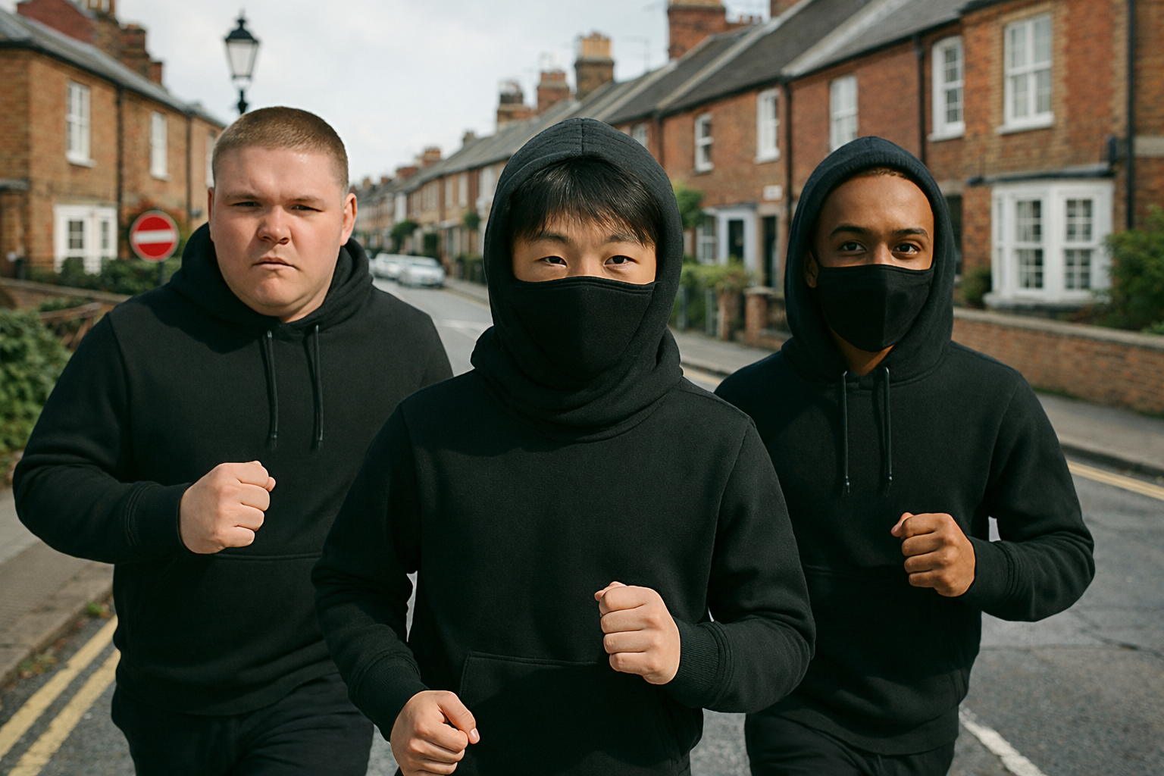
Writing Task
Success Criteria - Identify how Blake speaks to Dylan and Tyler and how he frames their actions. - Explain how the knife and the term ‘The Boys’ symbolise status and threat. - Link the group’s behaviour to wider themes of peer pressure and reputation.
Know - Blake is presented as a self-proclaimed leader who uses threats, loyalty, and image to control others. - The gang name ‘The Boys’ and the knife function as symbols of power and intimidation. - The chase scene shows how fear and pressure can drive Michael into life-threatening danger.
Show - Annotate the initiation scene and first attack, focusing on Blake’s commands and the use of the knife. - Write a paragraph explaining how Mullings uses the group to comment on peer pressure and toxic loyalty.
Create PETAZL Paragraph including Knows and Shows based on what you have read so far including how Mullings shows that ‘The Boys’ are dangerous and powerful?
You might not have heard of PETAZL paragraphs, but they are a good way of writing out analytical paragraphs.
P = Point you are making
E = “Evidence”
T = Technique (Language)
A = Analysis (Explanation)
Z = Zoom (Zoom in on the quote)
L = Link. Link back to the question.

Slide 8
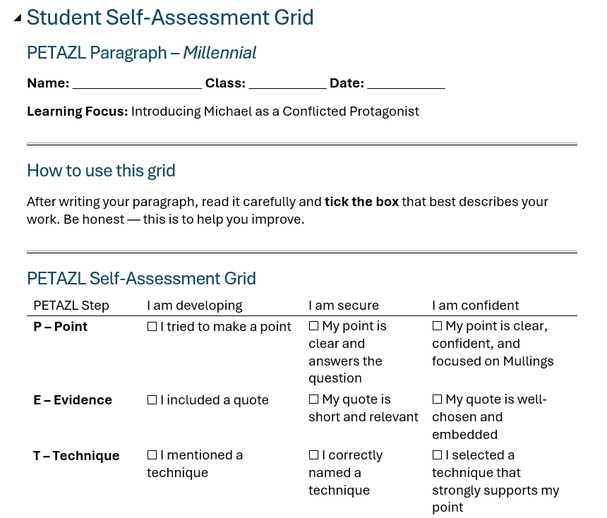
PLENARY: Student Self-Assessment Grid (full word document provided) to complete as a class to consolidate learning and avoid any misconceptions. Use the Demystification document to help support students that require further clarity.

